Slide 1
Automated Multi-Label Thoraic Disease Diagnosis from Chest X-Rays
Submitted in the partial fulfillment for the award of the degree of
BACHELOR OF ENGINEERING
IN
Artificial Intelligence and Machine Learning
Submitted by:
Sahil Jana-22BAI71057
Raj Guru-22BAI71085
Chhanak Dixit-22BAI71103
Diya Choudhary-22BAI71111
Under the Supervision of:
Prof. Harjot Singh
Department of AIT-CSE
DISCOVER . LEARN . EMPOWER

Slide 2
Outline
Introduction to Project
Problem Formulation
Objectives of the work
Methodology used
Results and Outputs
Conclusion
Future Scope
References

Slide 3
Introduction to Project
Importance of Chest X-Rays
Most common and affordable imaging tool in medical diagnosis. Crucial for detecting diseases like pneumonia ,cardiomegaly, and pleural effusion. Non-invasive, quick, and widely available.
Challenges in Manual Diagnosis
Manual reading is time-consuming and requires specialized expertise. Errors may occur due to radiologist fatigue and workload .Difficulty in identifying multiple overlapping diseases from a single image.

Slide 4
Introduction to Project
Need for Automated Systems
Real-world cases often require multi-label classification (one X-ray showing multiple diseases).Traditional models focus on single-label, not practical for clinical settings.
Solution: Deep Learning Approach
Fine-tuned DenseNet121 model for multi-label disease classification . Utilizes ChestX-ray8 dataset (14 thoracic diseases).Enhances diagnostic speed, accuracy, and supports clinical workflows.

Slide 5
Problem Formulation
Challenges in Thoracic Disease Diagnosis
Chest X-rays often present multiple overlapping diseases in a single image.
Manual diagnosis is prone to :
Subjectivity based on radiologist experience.
Fatigue-related errors .
Inconsistency across different clinicians .
Traditional machine learning models assume single-label classification not suited for real-world multi-pathology cases.

Slide 6
Problem Formulation
Research Objective
Develop an automated deep learning model to identify multiple thoracic diseases from chest X-ray images.
Requirements:
Handle multi-label classification effectively.
Maintain high diagnostic accuracy across common and rare diseases.
Reduce radiologist workload and support early detection.
Approach: Fine-tune a DenseNet121 CNN model using the ChestX-ray8 dataset .Apply transfer learning, data augmentation, and regularization techniques for better generalization.

Slide 7
Objectives of the Work
Develop an automated system for multi-label classification of thoracic diseases from chest X-ray images.
Fine-tune DenseNet121 using the ChestX-ray8 dataset for effective feature extraction.
Apply transfer learning and data augmentation to improve model performance and generalization.
Achieve high accuracy, precision, and recall across both common and rare disease classes.
Reduce diagnostic workload for radiologists and enhance early disease detection .
Create a scalable pipeline adaptable to real-world clinical environments.

Slide 8
Methodology used
Data Acquisition and Preprocessing
Dataset: ChestX-ray8 (112,120 frontal chest X-ray images, 14 disease labels).
Preprocessing steps:
Resize images to 320×320 pixels.
Normalize pixel values to the [0,1] range.
Multi-label binary encoding of disease labels.
Split dataset into 80% training and 20% validation.
Data augmentation: horizontal flipping for better generalization.

Slide 9
Methodology used
2. Model Selection and Training Strategy
Model: Fine-tuned DenseNet121 (pre-trained on ImageNet).
Architecture modifications:
Removed top layer.
Added Global Average Pooling layer.
Added Dense layer (128 units, ReLU activation).
Final sigmoid-activated output layer (14 classes).
Training Approach:
Stage 1: Freeze all base layers and train classifier head (5 epochs).
Stage 2: Unfreeze last 30 DenseNet layers and fine-tune (10 epochs).Optimizer: Adam | Loss Function: Binary Cross-Entropy | Batch Size: 32

Slide 10
Methodology used
3. Evaluation and Comparison Evaluation Metrics:
Accuracy, Precision, Recall, F1-Score (per class and weighted averages).
Parallel Experiment:
MobileNetV2 tested as a lightweight alternative.
DenseNet121 outperformed MobileNetV2 in multi-label accuracy.
Prediction Threshold:
Applied 0.5 threshold per class for decision-making.
Toolkits Used:
Python 3.10, TensorFlow, OpenCV, Scikit-learn, Matplotlib.

Slide 11
Results and Outputs
The empirical results of the proposed chest X-ray classification model using MobileNetV2. The model was evaluated across two experimental settings—2 epochs and 5 epochs—to analyze its learning dynamics.
Performance After 2 Epochs
After two epochs of training, the model achieved a validation accuracy of 55.24%.
Quantitative analysis revealed a substantial bias toward the dominant "No Finding" class.

Slide 12
Results and Outputs
Classification Report
Metric Type | Value
Validation Accuracy | 55.24%
Macro F1-Score | 0.00
Weighted F1-Score | 0.27
Sample-wise F1-Score | 0.39
Weighted Precision | 0.27
Weighted Recall | 0.31

Slide 13
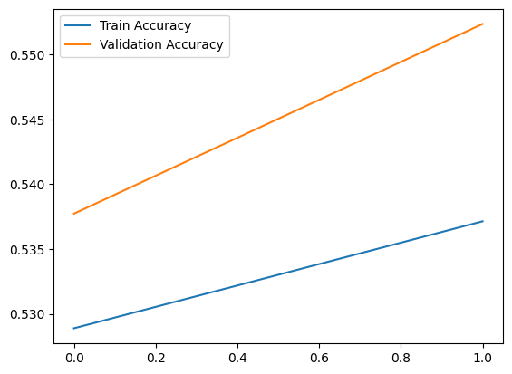
Results and Outputs
Visual Results
Training vs Validation Accuracy for 2 Epochs

Slide 14
Results and Outputs
The blue line represents Training Accuracy, and the orange line represents Validation Accuracy.
Both line are increasing as whatever is on x axis increases.
The Validation Accuracy is consistently higher than the Training Accuracy.
The overall accuracy values are quite low, around 53–55%.

Slide 15
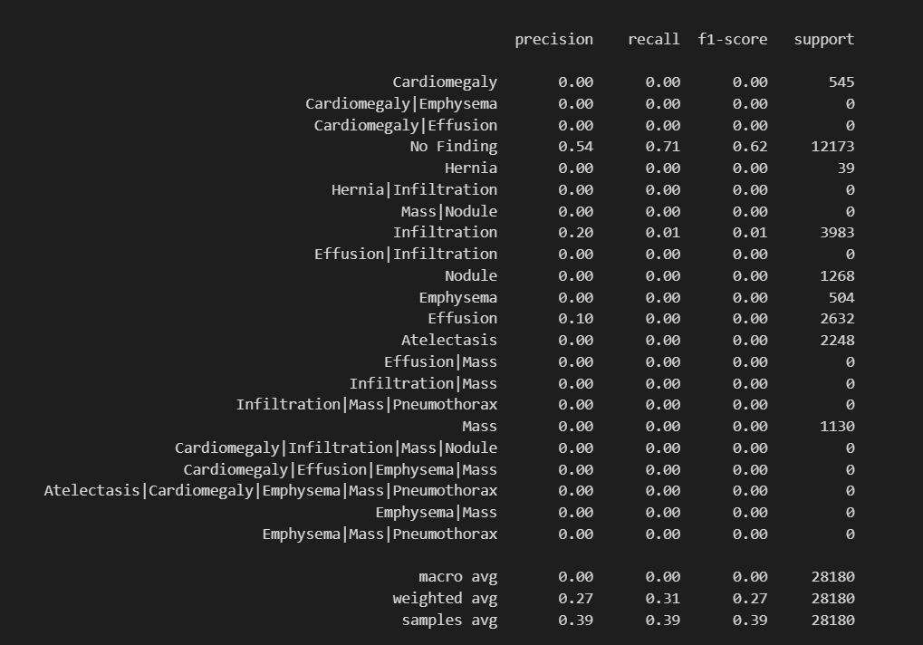
Results and Outputs
Confusion Matrix

Slide 16
Results and Outputs
Confusion Matrix provides an intuitive visualization of how the model performs across multiple classes.
• High diagonal intensity for the “No Finding” class indicates it was most often correctly predicted.
• Disease-specific classes (e.g., “Effusion,” “Infiltration,” “Mass”) showed minimal true positives, with most predictions either being misclassified or ignored.
• Overlapping and composite labels (e.g., “Effusion|Mass”) had no clear mapping, further emphasizing the challenge in multi-label medical

Slide 17
Results and Outputs
Performance After 5 Epochs
Although the observed trends during 5 epochs include:
• Training Accuracy improved to approximately 63%
• Validation Accuracy increased to 60.3%
• Weighted F1-score rose slightly to around 0.32

Slide 18
Conclusion
Successfully developed an automated multi-label classification system for thoracic disease detection from chest X-rays.
Utilized DenseNet121 with transfer learning and fine-tuning for improved feature extraction.
Achieved moderate validation accuracy (~60%) within limited training epochs.
Model performed well on dominant disease classes, but struggled with rare and overlapping pathologies.
Demonstrated the feasibility of deep learning models to assist radiologists and reduce diagnostic workload.
Highlights the need for longer training, advanced balancing techniques, and interpretability for clinical deployment.

Slide 19
Future Scope
Handle Class Imbalance: Use techniques like SMOTE, class weighting, and oversampling.
Advanced Loss Functions: Implement Focal Loss or weighted binary cross-entropy to improve rare disease detection.
Explainable AI: Integrate tools like Grad-CAM for better model transparency and clinical trust.
Extended Training: Train over more epochs with larger subsets of fine-tuned layers for better feature learning.
Expanded Datasets: Incorporate additional datasets like CheXpert or Vin Dr-CXR for improved generalization.
Mobile and Real-Time Applications: Optimize lightweight models (e.g., MobileNetV2, Efficient Net-lite) for mobile or embedded medical devices.

Slide 20
References
[1] X. Wang, Y. Peng, L. Lu, Z. Lu, M. Bagheri, and R. M. Summers, "ChestX-ray8: Hospital-scale chest X-ray database and benchmarks on weakly-supervised classification and localization of common thorax diseases," in Proc. IEEE Conf. Comput. Vis. Pattern Recognit. (CVPR), 2017, pp. 2097–2106.
[2] P. Rajpurkar et al., "CheXNet: Radiologist-level pneumonia detection on chest X-rays with deep learning," arXiv preprint arXiv:1711.05225, 2017.
[3] G. Litjens et al., "A survey on deep learning in medical image analysis," Med. Image Anal., vol. 42, pp. 60–88, Dec. 2017.
[4] T. Saito and M. Rehmsmeier, "The precision-recall plot is more informative than the ROC plot when evaluating binary classifiers on imbalanced datasets," PLOS ONE, vol. 10, no. 3, pp. e0118432, Mar. 2015.
[5] T.-Y. Lin et al., "Focal loss for dense object detection," in Proc. IEEE Int. Conf. Comput. Vis. (ICCV), 2017, pp. 2980 2988.
[6] A. Howard et al., "MobileNets: Efficient convolutional neural networks for mobile vision applications," arXiv preprint arXiv:1704.04861, 2017.

Slide 21
References
[7] D. Bysani and R. Natarajan, "An ensemble deep learning model for pneumonia detection in chest X-ray images using DNN, CNN and transfer learning," in Proc. IEEE Int. Conf. Comput. Intell. Comput. Res. (ICCIC), 2020, pp. 1–6.
[8] H. Aggarwal, S. Rawat, and P. Narula, "Comparative analysis of VGG16, ResNet50 and DenseNet121 for classification of COVID-19 CT images using transfer learning," in Proc. IEEE Int. Conf. Comput. Power, Energy, and Controls (ICCPPEC), 2021, pp. 1–6.
[9] M. T. Islam, M. A. Aowal, A. Minhaz, and K. Ashraf, "Abnormality detection and localization in chest X-rays using deep convolutional neural networks," arXiv preprint arXiv:1705.09850, 2017.
[10] M. Y. Ng, E. Y. P. Lee, J. Yang, et al., "Imaging profile of the COVID-19 infection: radiologic findings and literature review," Radiology: Cardiothoracic Imaging, vol. 2, no. 1, pp. e200034, 2020.
[11] S. Irvin et al., "CheXpert: A large chest radiograph dataset with uncertainty labels and expert comparison," in Proc. AAAI Conf. Artif. Intell., vol. 33, 2019, pp. 590–597.
[12] H. T. Nguyen et al., "VinDr-CXR: An open dataset of chest X-rays with radiologist annotations," PhysioNet, 2020. [Online].
[13] F. Chollet, "Xception: Deep learning with depthwise separable convolutions," in Proc. IEEE Conf. Comput. Vis. Pattern Recognit. (CVPR), 2017, pp. 1251–1258.
[14] M. Abadi et al., "TensorFlow: A system for large-scale machine learning," in Proc. 12th USENIX Conf. Oper. Syst. Design Implement. (OSDI), 2016, pp. 265–283.

